Slide 1
Investigating System Requirements
Chapter 2
Systems Analysis and Design in a Changing World 7th Ed
Satzinger, Jackson & Burd

Slide 2
Chapter 2 Outline
Systems Analysis Activities
What Are Requirements?
Stakeholders
Information-Gathering Techniques
Models and Modeling
Documenting Workflows with Activity Diagrams

Slide 3
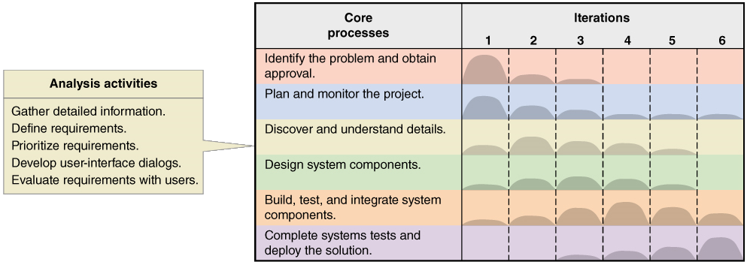
Systems Analysis Activities Involve discovery and understanding

Slide 4
Systems Analysis Activities
Gather Detailed Information
Interviews, questionnaires, documents, observing business processes, researching vendors, comments and suggestions
Define Requirements
Modeling functional requirements and non-functional requirements
Prioritize Requirements
Essential, important, vs. nice to have
Develop User-Interface Dialogs
Flow of interaction between user and system
Evaluate Requirements with Users
User involvement, feedback, adapt to changes

Slide 5
What Are Requirements?
System Requirements =
Functional requirements
Non-functional requirements
Functional Requirements– the activities the system must perform
Business uses, functions the users carry out
Shown as use cases in Chapter 1
Non-Functional Requirements– other system characteristics
Constraints and performance goals

Slide 6
FURPS+ Requirements Acronym
Functional requirements
Usability requirements
Reliability requirements
Performance requirements
Security requirements
+ even more categories…

Slide 7
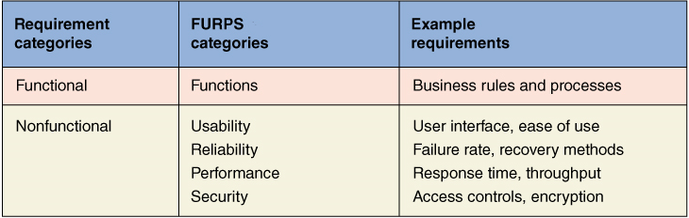
FURPS+ Requirements Acronym

Slide 8
Additional Requirements Categories
Design constraints –
Specific restrictions for hardware and software
Implementation requirements
Specific languages, tools, protocols, etc.
Interface requirements
Interface links to other systems
Physical requirements
Physical facilities and equipment constraints
Supportability requirements
Automatic updates and enhancement methods
Systems Analysis and Design in a Changing World, 7th Edition - Chapter 2

Slide 9
Stakeholders Who do you involve and talk to?
Stakeholders– persons who have an interest in the successful implementation of the system
Internal Stakeholders– persons within the organization
External stakeholders – persons outside the organization
Operational stakeholders – persons who regularly interact with the system
Executive stakeholders– persons who don’t directly interact, but use the information or have financial interest

Slide 10
Stakeholders of a comprehensive accounting system for public company

Slide 11
Information Gathering Techniques
Interviewing users and other stakeholders
Distributing and collecting questionnaires
Reviewing inputs, outputs, and documentation
Observing and documenting business procedures
Researching vendor solutions
Collecting active user comments and suggestions

Slide 12
Interviewing Users and Other Stakeholders
Prepare detailed questions
Meet with individuals or groups of users
Obtain and discuss answers to the questions
Document the answers
Follow up as needed in future meetings or interviews

Slide 13
Question Types
Questions can be roughly divided into two types:
Open-ended questions: How do you do this function?
Closed-ended questions: How many forms a day do you process?

Slide 14
Themes for Information Gathering Questions

Slide 15
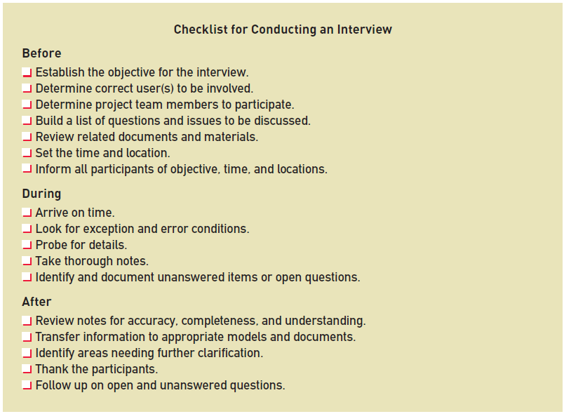
Preparing for the Interview

Slide 16
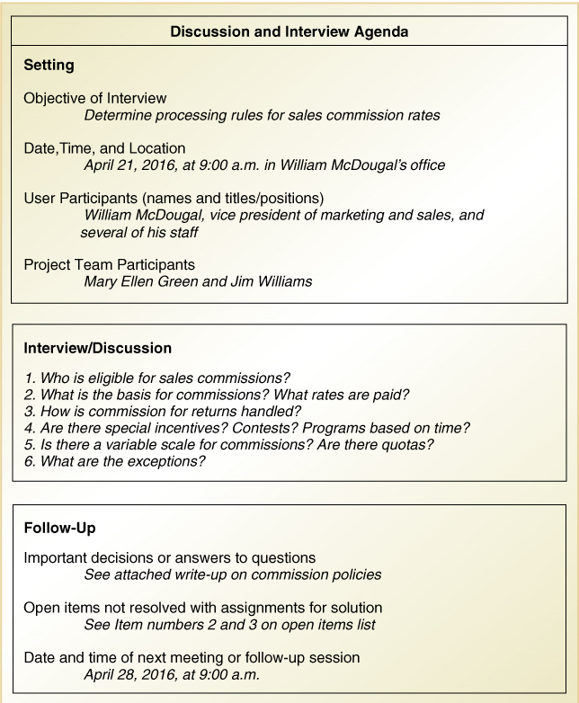
Interview Session Agenda

Slide 17
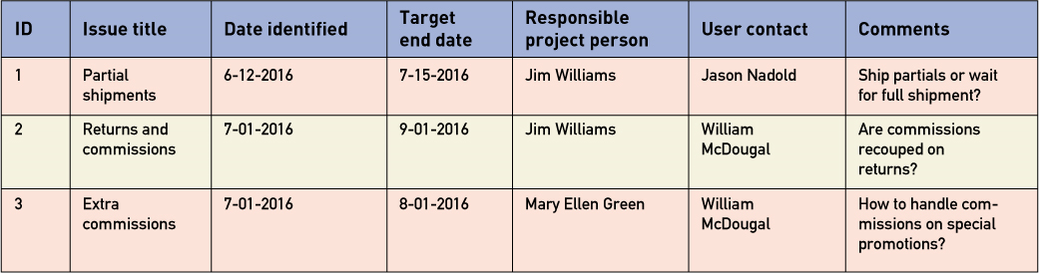
Keeping an Open Items List

Slide 18
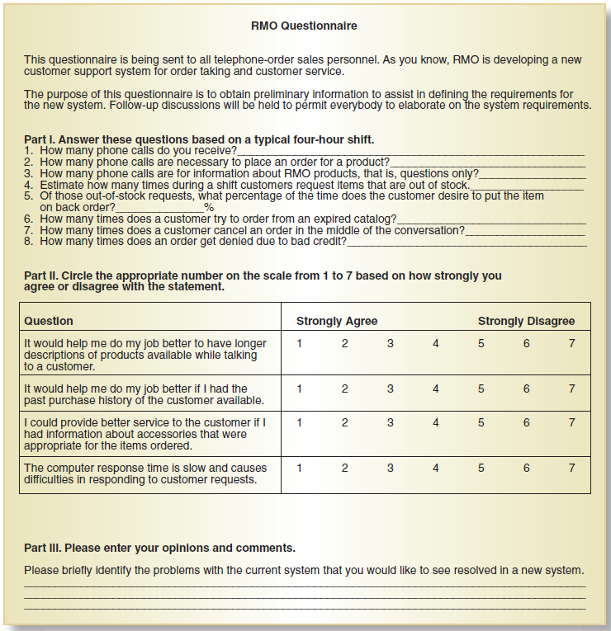
Distribute and Collect Questionnaires

Slide 19
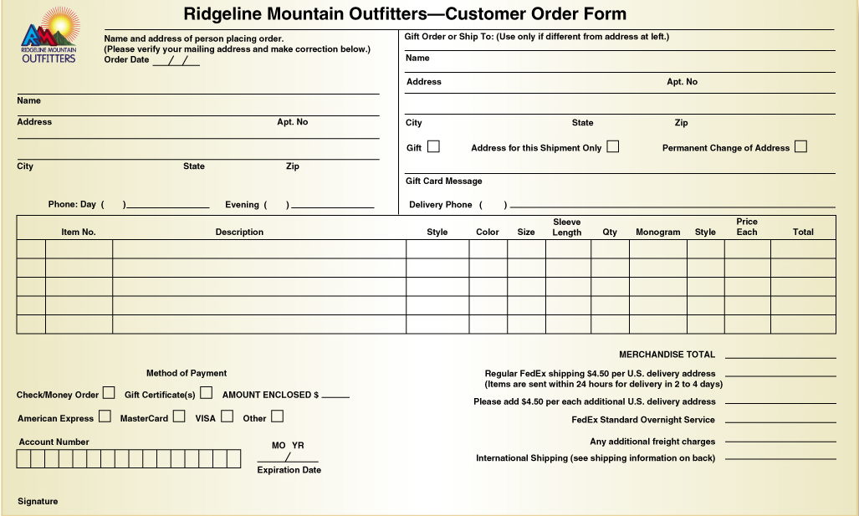
Review Inputs, Outputs, and Procedures

Slide 20
Additional Techniques
Observe and Document Business Processes
Watch and learn
Document with Activity diagram (next section)
Research Vendor Solutions
See what others have done for similar situations
White papers, vendor literature, competitors
Collect Active User Comments and Suggestions
Feedback on models and tests
Users know it when the see it

Slide 21
Models and Modeling
How do we define requirements? After collecting information, create models
Model– a representation of some aspect of the system being built
Types of Models
Textual model– something written down, described
Graphical models– diagram, schematic
Mathematical models– formulas, statistics, algorithms
Unified Modeling Language (UML)
Standard graphical modeling symbols/terminology used for information systems

Slide 22
Reasons for Modeling
Learning from the modeling process
Reducing complexity by abstraction
Remembering all the details
Communicating with other development team members
Communicating with a variety of users and stakeholders
Documenting what was done for future maintenance/enhancement

Slide 23
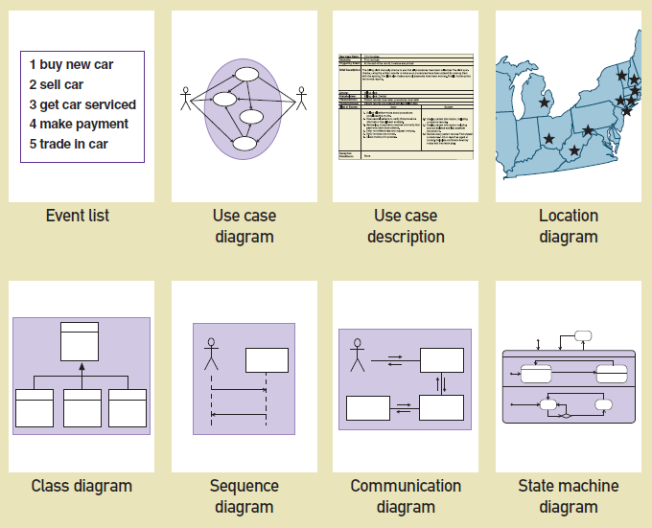
Some Analysis and Design Models

Slide 24
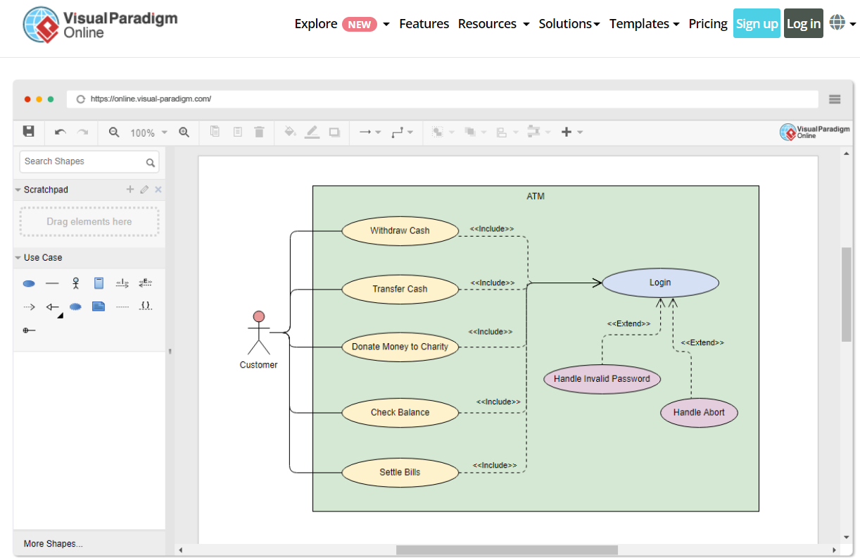
Use Case Diagram

Slide 25
Documenting Workflows with Activity Diagrams
Workflow– sequence of processing steps that completely handles one business transaction or customer request
Activity Diagram– describes user (or system) activities, the person who does each activity, and the sequential flow of these activities
Useful for showing a graphical model of a workflow
A UML diagram

Slide 26
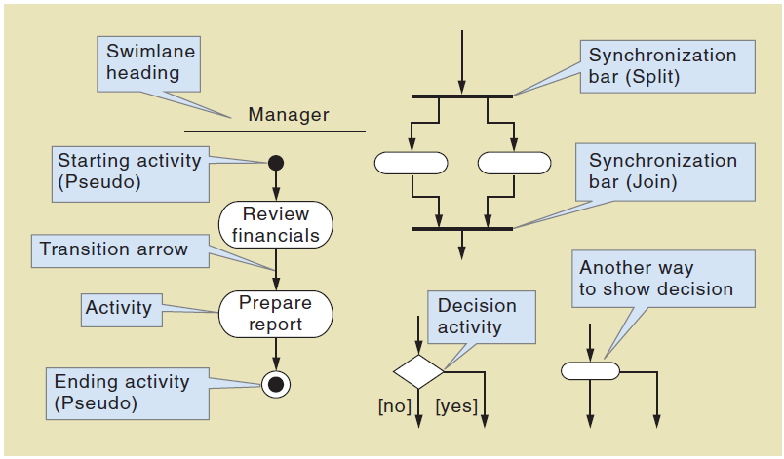
Activity Diagrams Symbols

Slide 27
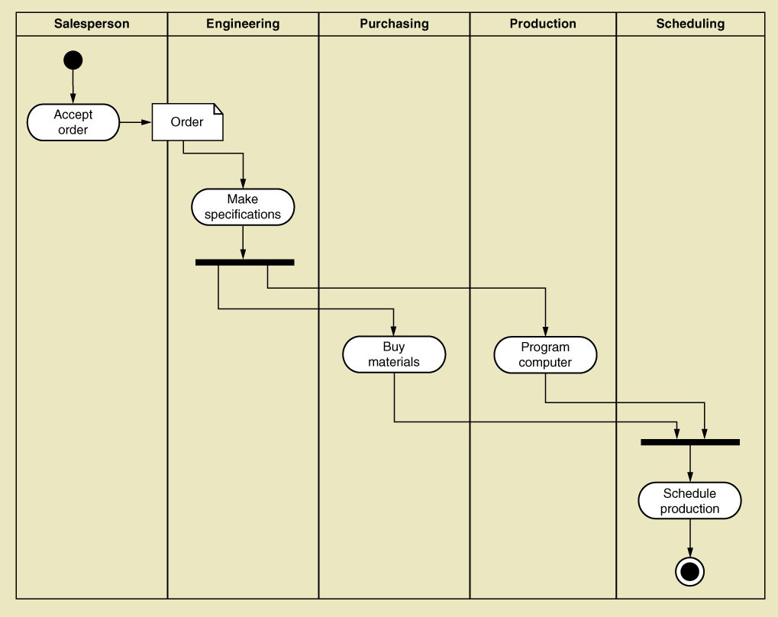
Activity Diagram with Concurrent Paths

